Slide 1
Cloud Computing
SEWP ZG527

Slide 2
Introduction to cloud security
If cloud computing is so great, why isn’t everyone doing it?
The cloud acts as a big black box, nothing inside the cloud is visible to the clients
Clients have no idea or control over what happens inside a cloud
Even if the cloud provider is honest, it can have malicious system admins who can tamper with the VMs and violate confidentiality and integrity
Clouds are still subject to traditional data confidentiality, integrity, availability, and privacy issues, plus some additional attacks
Notes:
RL 7.3

Slide 3
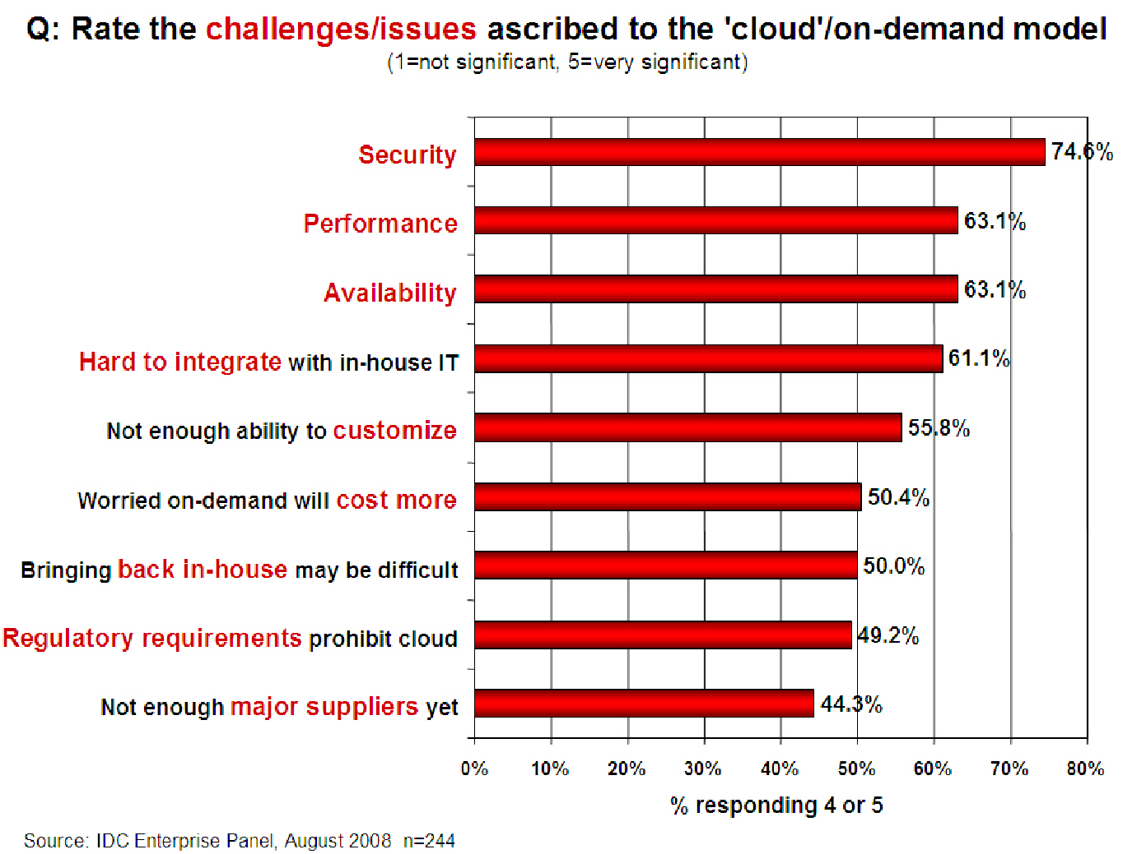
Companies are still afraid to use clouds

Slide 4
Cloud Security Issues
Most security problems stem from:
Loss of Control
Take back control
Data and apps may still need to be on the cloud
But can they be managed in some way by the consumer?
Lack of trust
Increase trust (mechanisms)
Technology
Policy, regulation
Contracts (incentives): topic of a future talk
Multi-tenancy
Private cloud
Takes away the reasons to use a cloud in the first place
VPC: its still not a separate system
Strong separation
These problems exist mainly in 3rd party management models
Self-managed clouds still have security issues, but not related to above

Slide 5
Loss of Control in the Cloud
Consumer’s loss of control
Data, applications, resources are located with provider
User identity management is handled by the cloud
User access control rules, security policies and enforcement are managed by the cloud provider
Consumer relies on provider to ensure
Data security and privacy
Resource availability
Monitoring and repairing of services/resources

Slide 6
Multi-tenancy Issues in the Cloud
Conflict between tenants’ opposing goals
Tenants share a pool of resources and have opposing goals
How does multi-tenancy deal with conflict of interest?
Can tenants get along together and ‘play nicely’ ?
If they can’t, can we isolate them?
How to provide separation between tenants?
Cloud Computing brings new threats
Multiple independent users share the same physical infrastructure
Thus an attacker can legitimately be in the same physical machine as the target

Slide 7
Taxonomy of Fear
Confidentiality
Fear of loss of control over data
Will the sensitive data stored on a cloud remain confidential?
Will cloud compromises leak confidential client data
Will the cloud provider itself be honest and won’t peek into the data?
Integrity
How do I know that the cloud provider is doing the computations correctly?
How do I ensure that the cloud provider really stored my data without tampering with it?

Slide 8
Taxonomy of Fear
Availability
Will critical systems go down at the client, if the provider is attacked in a Denial of Service attack?
What happens if cloud provider goes out of business?
Would cloud scale well-enough?
Often-voiced concern
Although cloud providers argue their downtime compares well with cloud user’s own data centers

Slide 9
Taxonomy of Fear
Privacy issues raised via massive data mining
Cloud now stores data from a lot of clients, and can run data mining algorithms to get large amounts of information on clients
Increased attack surface
Entity outside the organization now stores and computes data, and so
Attackers can now target the communication link between cloud provider and client
Cloud provider employees can be phished

Slide 10
Taxonomy of Fear
Audit-ability and forensics (out of control of data)
Difficult to audit data held outside organisation in a cloud
Forensics also made difficult since now clients don’t maintain data locally
Legal quagmire and transitive trust issues
Who is responsible for complying with regulations?
e.g., SOX, HIPAA, GLBA ?
If cloud provider subcontracts to third party clouds, will the data still be secure?

Slide 11
Threat Model
A threat model helps in analysing a security problem, design mitigation strategies, and evaluate solutions
Steps:
Identify attackers, assets, threats and other components
Rank the threats
Choose mitigation strategies
Build solutions based on the strategies

Slide 12
Threat Model
Basic components
Attacker modelling
Choose what attacker to consider
insider vs. outsider?
single vs. collaborator?
Attacker motivation and capabilities
Attacker goals
Vulnerabilities / threats

Slide 13
Thank you

